Slide 1
High-throughput chromatin immunoprecipitation assays
BioConductor 2013
Sangsoon Woo, Arnaud Droit, Xuekui Zhang,
Fred Hutchinson Cancer Reserach Center,
Seattle

Slide 2
Outline
High throughput sequencing and ChIP-Seq
A probabilistic approach to the analysis of ChIP- Seq
Example on real data and comparison to other approaches
Nucleosome positioning

Slide 3
ChIP-Seq
Couple ChIP with HTS
A typical ChIP-Seq experiment generates millions of short reads
Read lengths are in the order of 50-150bps
Because of chromatin, antibodies and alignment biases, a control sample is still recommended

Slide 4
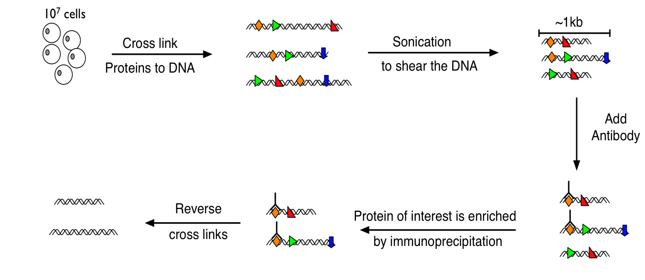
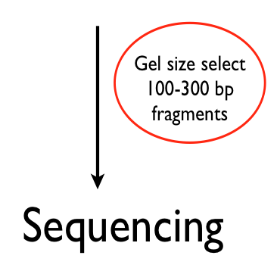
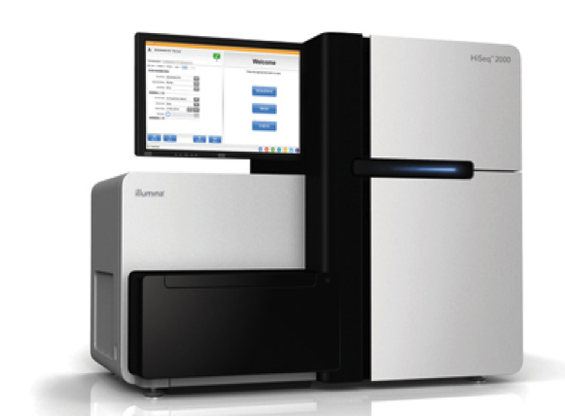
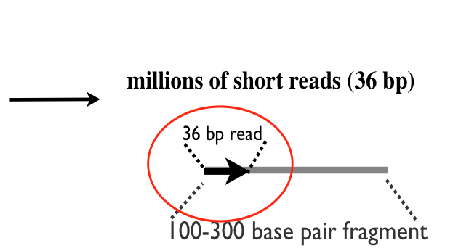
ChIP-Seq
Notes:
1) A DNA-binding protein is cross-linked to its in vivo genomic DNA targets and the chromatin is isolated
2) The DNA with the bound proteins is extracted from the cells and is sheared by sonication into fragment lenght 500-1000 pbs
3) DNA fragments that are cross-linked to the protein of interest are enriched by immunoprecipitation with an antibody that specifically binds that protein
4) The DNA is sperated from the protein
5) The resulting suspension of IP-enriched DNA is size selected on a gel and only smaller fragments are retained
6) The IP-enriched DNA is sequenced to generate millions of short reads

Slide 5
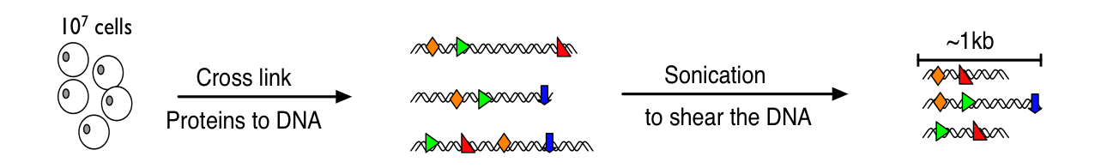
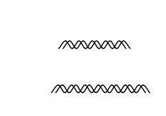
ChIP-Seq: control
Reverse cross link

Slide 6
Aligners
The first step consists of aligning raw reads to the reference genome.
There exists numerous “aligners” or “mappers”
Here are a few popular ones: Bowtie, BWA, ELAND, MAQ, etc
Aligning raw reads can take from several hours to several days (depends on data, software and cpu)
Most aligners will perform “just fine” for ChIP- Seq

Slide 7
Aligned Reads
Once reads have been aligned, we obtained a bed like file with chromosome, start, end and strand information for each sequence
Some reads cannot be uniquely aligned, and are typically discarded
R and Bioconductor provide basic sequence alignment capabilities and great input support (Biostrings, ShortReads)
ShortReads can read most aligner data formats

Slide 8
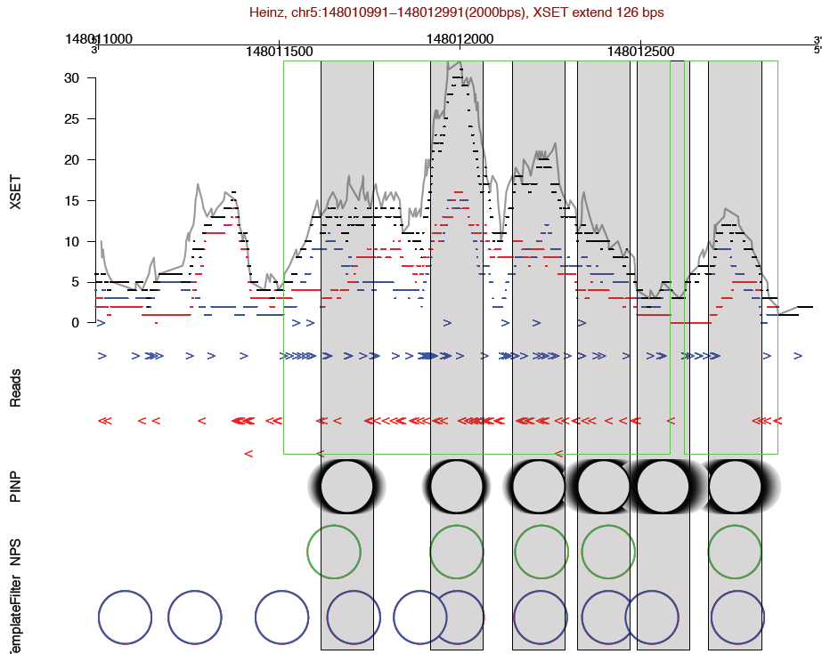
Peak calling
Aligned read data are transformed into a form that reflects local densities of immunoprecipitated DNA fragments → Peaks
Estimate locations where transcription factors(TF) were associated with DNA → Peak summit
Assign a score to each of these locations → Enrichment score
Estimate a score threshold that leads to a desired false positive rate (or FDR) → thresholding

Slide 10
Peak callers for TF
MACS → Yong Zhang et al
cisGenome → Hongkai Ji et al
USEQ → David Nix et al
PICS
…

Slide 11
Our approach: PICS (Probabilistic Inference of ChIP-Seq data)
Probabilistic model:
Model binding events
Use prior information (Fragment length distribution)
Bidirectional reads
Measures of uncertainty
Estimation of missing reads
Resolve adjacent binding sites using mixture models
Implemented in BioConductor

Slide 12
PICS R package
Perform the segmentation and PICS fitting
Efficient implementation in C
Parallel running with multiple CPUs
Estimate the FDR and plot the FDR vs. score
Export to bed/wig
Can be fine tuned based on your fragment length distribution

Slide 13
Preprocessing
Divide the genomic reads into regions with “enough” F/R reads
Scan the genome every 10 pbs with a sliding window of size 150 bps
Minimum number of F reads on the left and R reads on the right
Merge overlapping regions
N disjoint candidate regions
Model each region separately

Slide 14
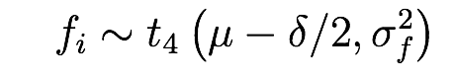
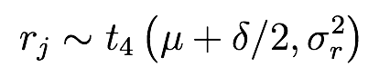
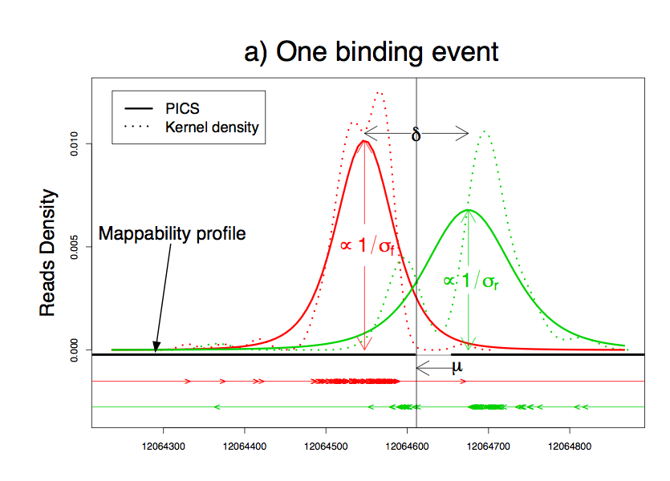
Modeling bi-directional reads
Kernel density
Unmappable region
Aligned Reads
: TF binding site position
: average fragment length
14
Notes:
We illustrate PICS model using observed data in an example region from real data
Allgned reads
We denote Binding location as mu
We denote DNA fragment length as delta
Model forward/reverse reads density by t distribution
Unmappable regions
Kernel density give two Reverse (green) peaks

Slide 15
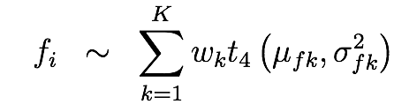
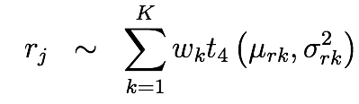
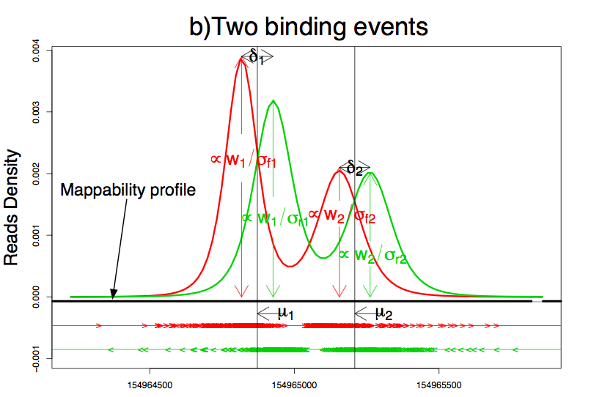
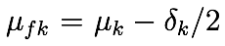
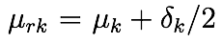
Modeling bi-directional reads
15
Notes:
We extend the model to multiple binding sites by using mixture models for forward/reverse peaks
The number of mixture components is selected using BIC
Delta enable us to pair F peaks with R peaks within reasonable distance on their right
Shared mixture weights allow us pair peaks with similar amount of reads, since DNA fragments have same prob to contribute F/R reads

Slide 16
Parameter estimation
Use an ECM type algorithm
E-step: Missing data are the cluster memberships and the weights of the normal distribution. Explicite formulation for the E-step
Mstep: No closed form estimates, so split into two M steps

Slide 17
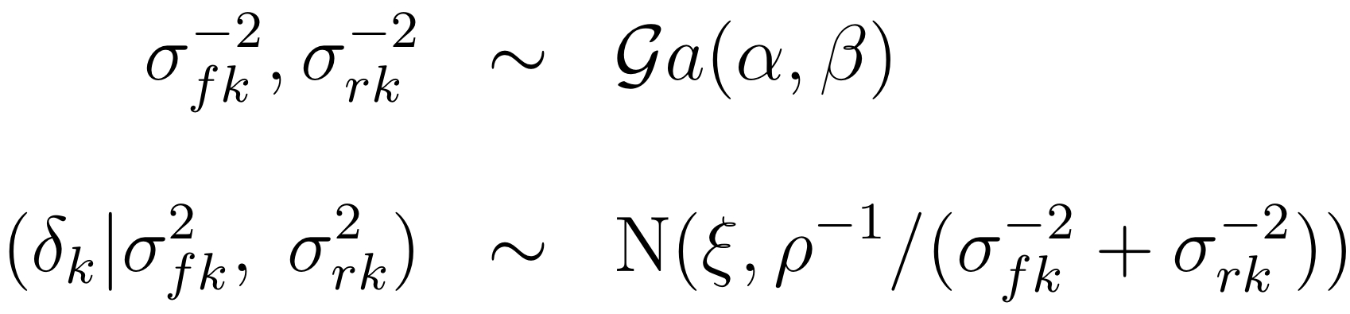
Prior distributions
Use Normal Inverse Gamma conjugate prior for computational convenience
Hyper-parameters are chosen to match our prior knowledge (eg. DNA fragment length 80-300 bps)
17

Slide 18
The missing reads
Genome is made of a short alphabet (A,G,C,T), hence sequence repeats can occur! So many short reads are discarded due to no uniquely aligned positions.
The amount of missing reads is unknown in each unmappable region.
Boundaries of unmappable regions are known -- (the 0/1 mappability profile obtained by exhaustive enumeration)
Use an idea of McLachlan and Jones (1998) for grouped and truncated data -- introducing latent variables:
amount of missing reads (negative multinomial)
positions of missing reads (same dist’n as observed reads)
We use EM algorithm for fitting hierarchical mixture models incorporating these latent variables
18
Notes:
Let’s discuss why there are missing reads and how to deal with that.

Slide 19
Scoring binding events
Compute an enrichment score to rank and identify an interesting list of binding events.
The enrichment score is defined as the ratio (IP/ Control) of the observed F/R reads falling in the 90% contours of the F/R distributions.
By swapping the IP/Control samples, we can get an estimate of the number of false positives for a given threshold, and thus compute an estimate of the FDR

Slide 20
Application to ER and FOXA1
FOXA1 data in human MCF7 human cells (Zhang et al., 2008).
3,909,507 treatment reads and 5,233,322 input DNA control reads
ER data data in human MCF7 human cells (Hu et al.,2010)
Use: PICS, rGADEM and MoTiV
HTC Droid DNA

Slide 21
Package ChipSeq
Packages:
ShortRead: to read data
BSGenome: to access genomic information
PICS: to identify peak list
rGADEM: de novo motif discovery
MotIV: motifs identifications
Rtracklayer: visualisation: interface to genome browser
GenomeGraphs: visualisation
Gviz: visualisation
PING: to identify nucleosome positioning

Slide 22
Average fragment length distribution

Slide 23
Visualizing candidate region

Slide 24
FDR

Slide 25
Vizualisation: GenomeGraphs

Slide 26
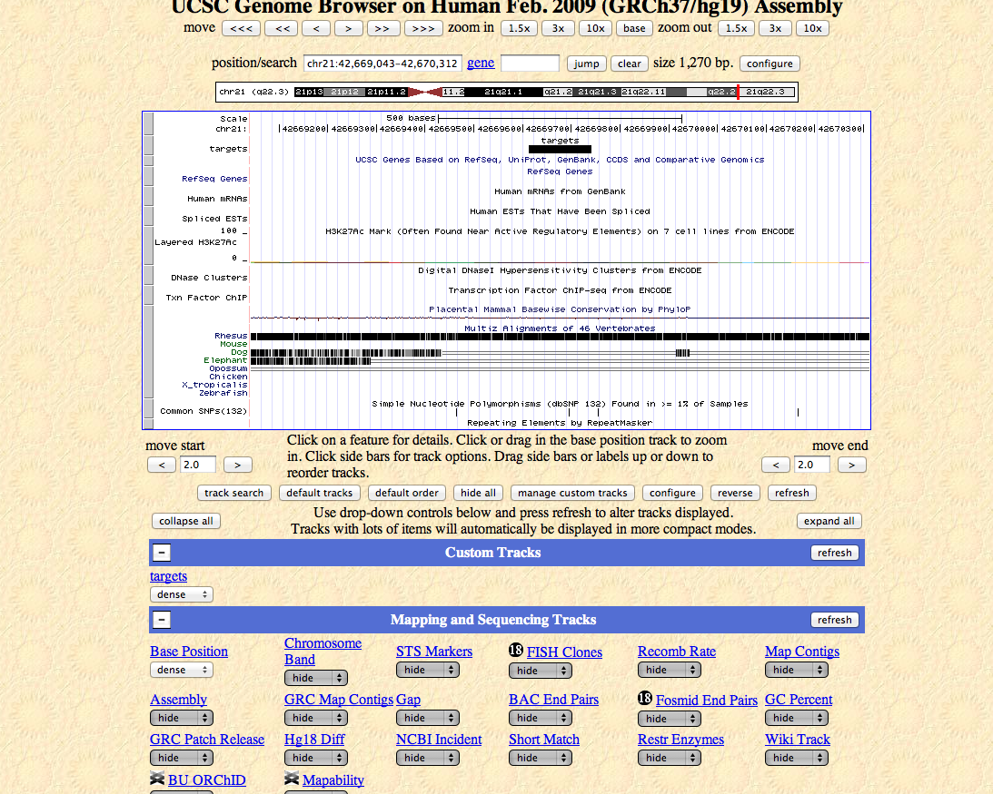
Vizualisation: rtracklayer

Slide 27
Validation
de novo motif search
Decided to use rGADEM because it is fast and can be used to process 10K+ sequences (binding site estimates +/- 100bps)
Identified motifs were then fed into MotIV and analyzed with Jaspar

Slide 28
rGADEM + MoTiV results

Slide 29
rGADEM + MoTiV results

Slide 30
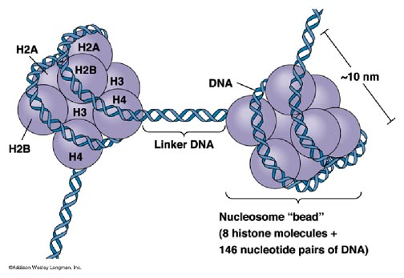
The biology – nucleosomes (1)
The nucleosome core particle (shown in the figure) consists of about 147 bps of DNA wrapped around the histone octamer. (H2A, H2B, H3, and H4)
Adjacent nucleosomes are joined by 10-80 bp of ‘linker’ DNA.
Notes:
The structure of nucleosome is shown as in the picture.
Its core is made from 8 proteins, 146 bp of DNA wrap around the core
Cores are linked by 10-80 bp linker DNA

Slide 31
The biology – nucleosomes (2)
DNA wrapped around nucleosomes is less accessible to DNA binding proteins. Hence nucleosomes can regulate processes that require access to DNA.
e.g. DNA replication or transcription
Many gene regulatory proteins interact with nucleosomes, such as modifying amino acids on N-terminal histone tails.
So genome-wide profiling nucleosome positions is important in understanding how transcriptional machinery functions in vivo.
Notes:
nucleosomes positions are important for DNA transcription and replication, and nucleosome interact with gene regulatory preteins, so inference of their locations is important

Slide 32
PING
We developed a new method, PING, for identifying nucleosome positioning from sequencing data.
PING is developed based on PICS framework, hence inherits all PICS features discussed above.
PING is different from PICS in:
Address spatial relations of nucleosomes (Gaussian Markov Random Field (GMRF) prior on nucleosome locations)
Other details. (New segmentation, new model selection criteria, new tuning parameters, and additional post-process step)

Slide 33
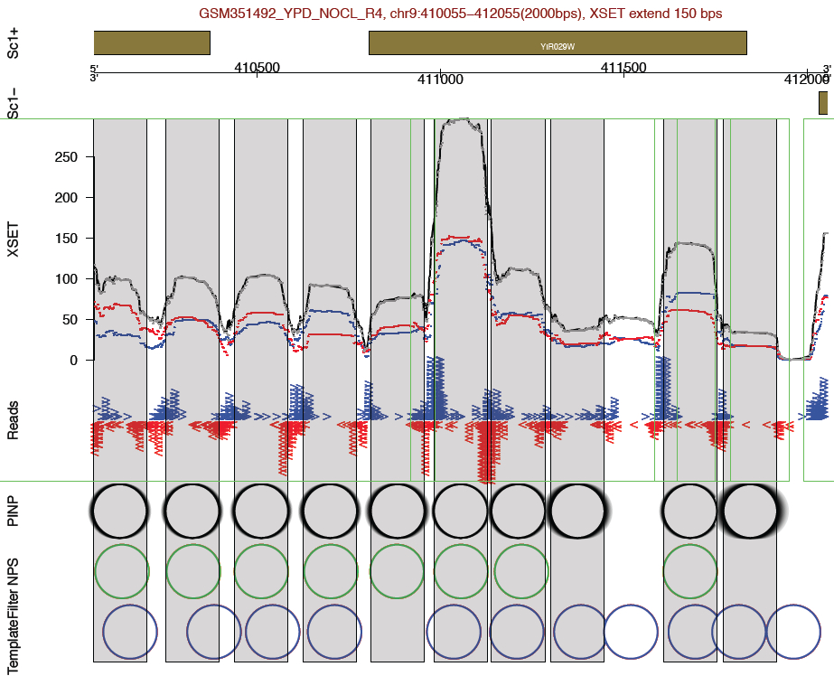
PING features
PING handle data from large genome (e.g. mammal) in ~ 1hr.
PING is robust to low read densities (simulation comparisons shown later)
PING handle both Sonication data and MNase data
MNase-seq
Sonicated ChIP-seq
Notes:
Not only clean MNase data, but also more challenging sonication data

Slide 34
PING R package
Work for MNase and Sonicated with Single-End and Paired-End sequencing data
Perform the segmentation and PING fitting
Efficient implementation in C
Parallel running with multiple CPUs
Export PING and postPING results to bed/wig
Built-in plotting function for Visualization
Notes:
Most peal-calling packages such as nucleR or ChIPseqR are for single-end data.

Slide 35
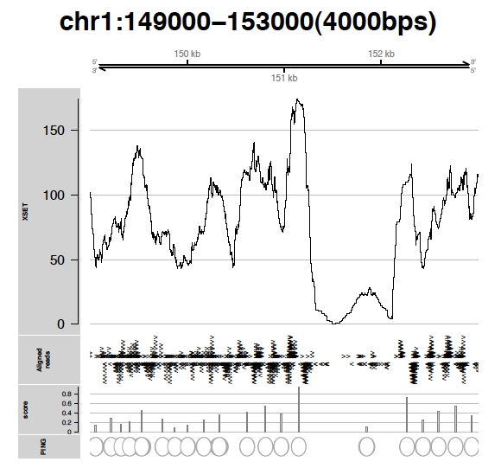
plotSummary()

Slide 36
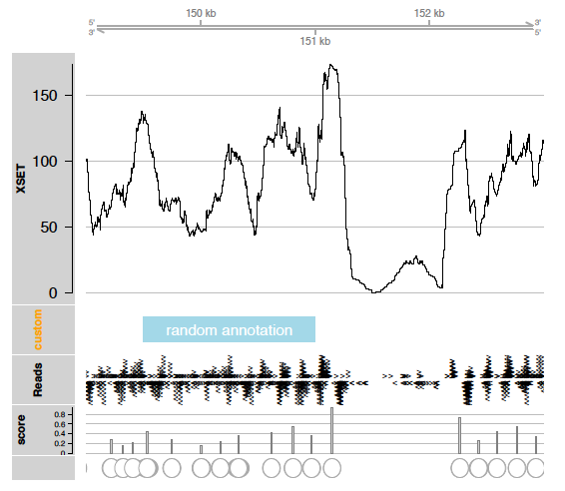
Custom plot with Gviz

Slide 37
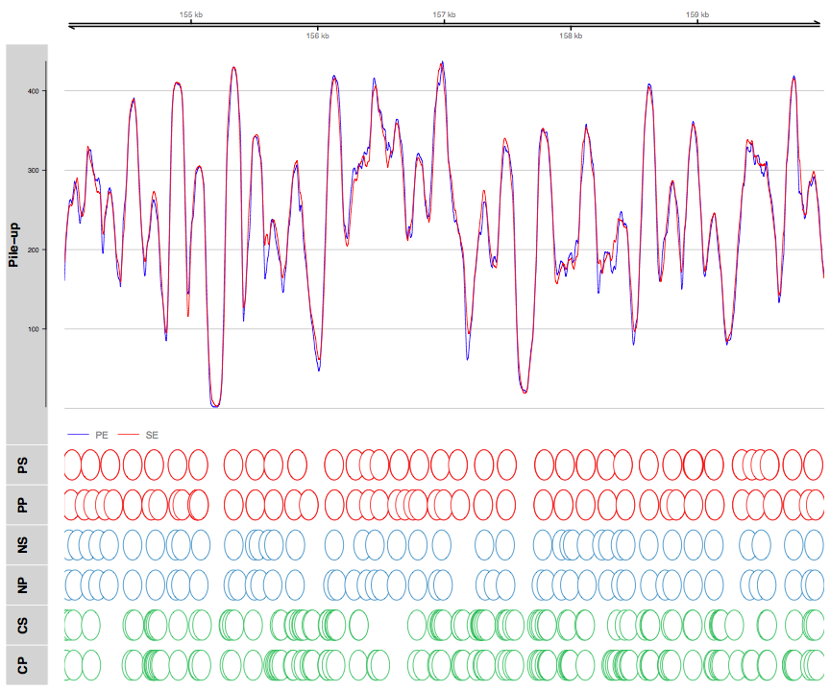
Custom plot with Gviz

Slide 38
Conclusions
ChIP is a powerful tool
Transcription factors
Epigenetics/Epigenomics
Statistics/Bioinformatics challenges
Alignment, detecting binding events, etc
Still many challenges with ChIP-Seq

